Slide 1
CREDIT RISK ANALYSIS USING R
EAODS PROJECT
Guided By:- S M Jaybhaye

Slide 2
Group Members
28 ARBAZ PATHAN (11910344)
29 PRATIK PATIL (11910518)
SANDESH PATIL (11911129)
34 HARSHJEET PATODE (12020075)
39 RAJAS RAMTEKE (11911051)

Slide 3



Data science approaches
Fraud detection
Architecture Diagram
Objectives
Methodology
References
Problem Statement

Slide 4
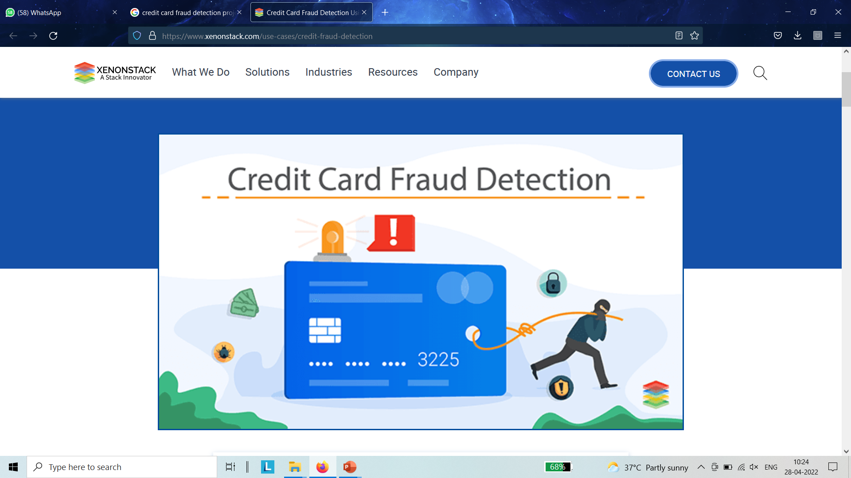
Problem Statement
To detect fraudulent credit card transactions over non-fraudulent transactions and to use machine learning algorithms to predict fraud efficiently and accurately.
The Credit Card Fraud Detection Problem includes
modeling past credit card transactions with the
knowledge of the ones that turned out to be fraud.
This model is then used to identify whether a new
transaction is fraudulent or not.

Slide 5

Objectives
To simulate and compare the results of the proposed scheme with the existing techniques of credit card fraud detection.
To study the various credit card fraud detection techniques in order to recognize their advantages and shortcomings.
To design an improved credit card fraud detection scheme using the data classification.
Our aim here is to detect 100% of the fraudulent transactions while minimizing the incorrect fraud classifications.

Slide 6
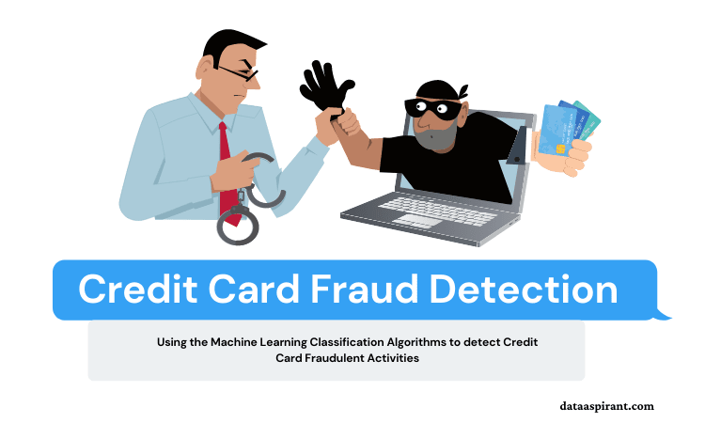
What is credit card fraud detection Does
The credit card fraud detection problem includes modelling past credit card transactions with the knowledge of the ones that turned out to be fraud
This model is then used to identify whether a new transaction is fraudulent or not
Our aim is to detect maximum of the fraudulent transactions while minimizing the incorrect fraud classifications

Slide 7


Data science approach
T
To leverage the vast amount of data collected from online transactions and model us to in a way to flag or predict fraud in future transactions
Two solutions
MACHINE LEARNING
Deep Neural Networks(DNN)

Slide 8

Data science approach
MACHINE LEARNING
ML encompasses large collection of algorithms and techniques used in classification,regression,clustering etc.
Data labelling
Supervised learning
Unbalanced data
PCA
Unsupervised learning
K-means

Slide 9
Architecture Diagram

Slide 10
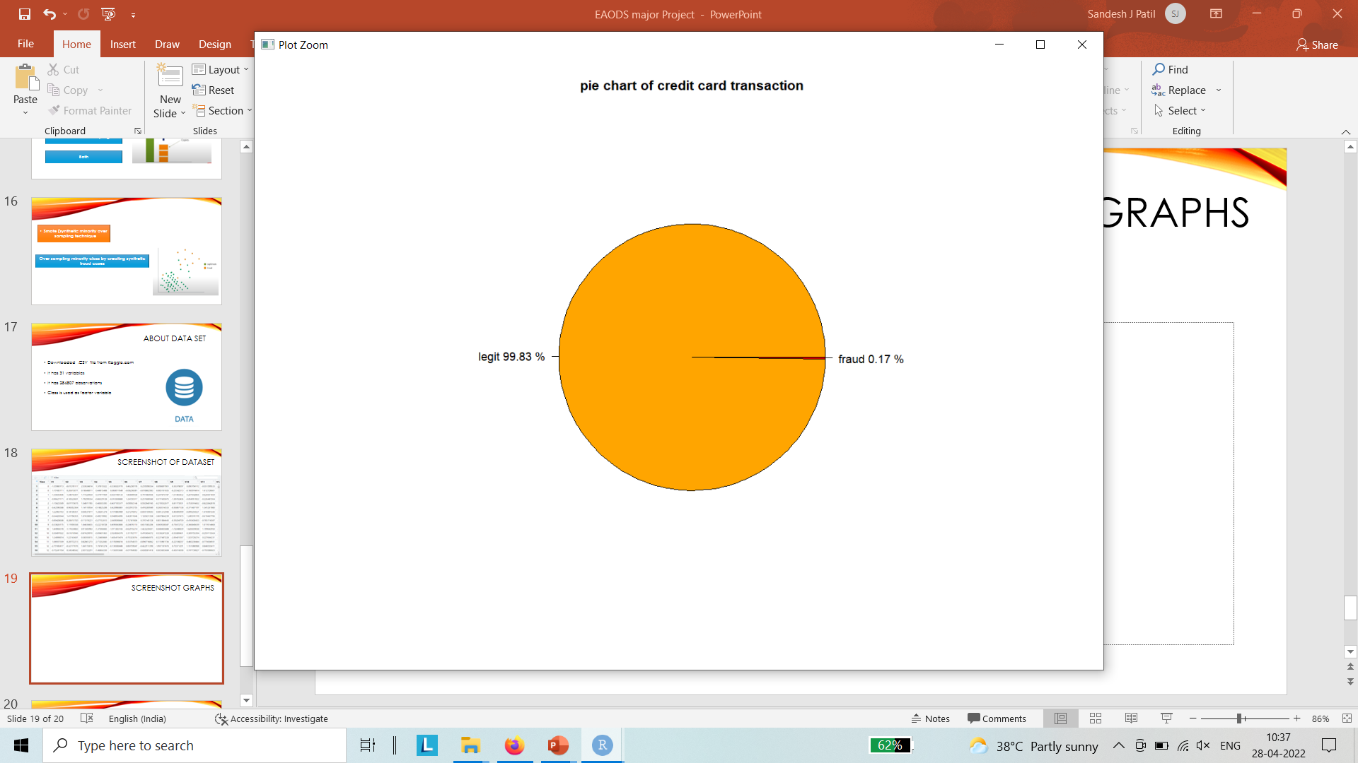
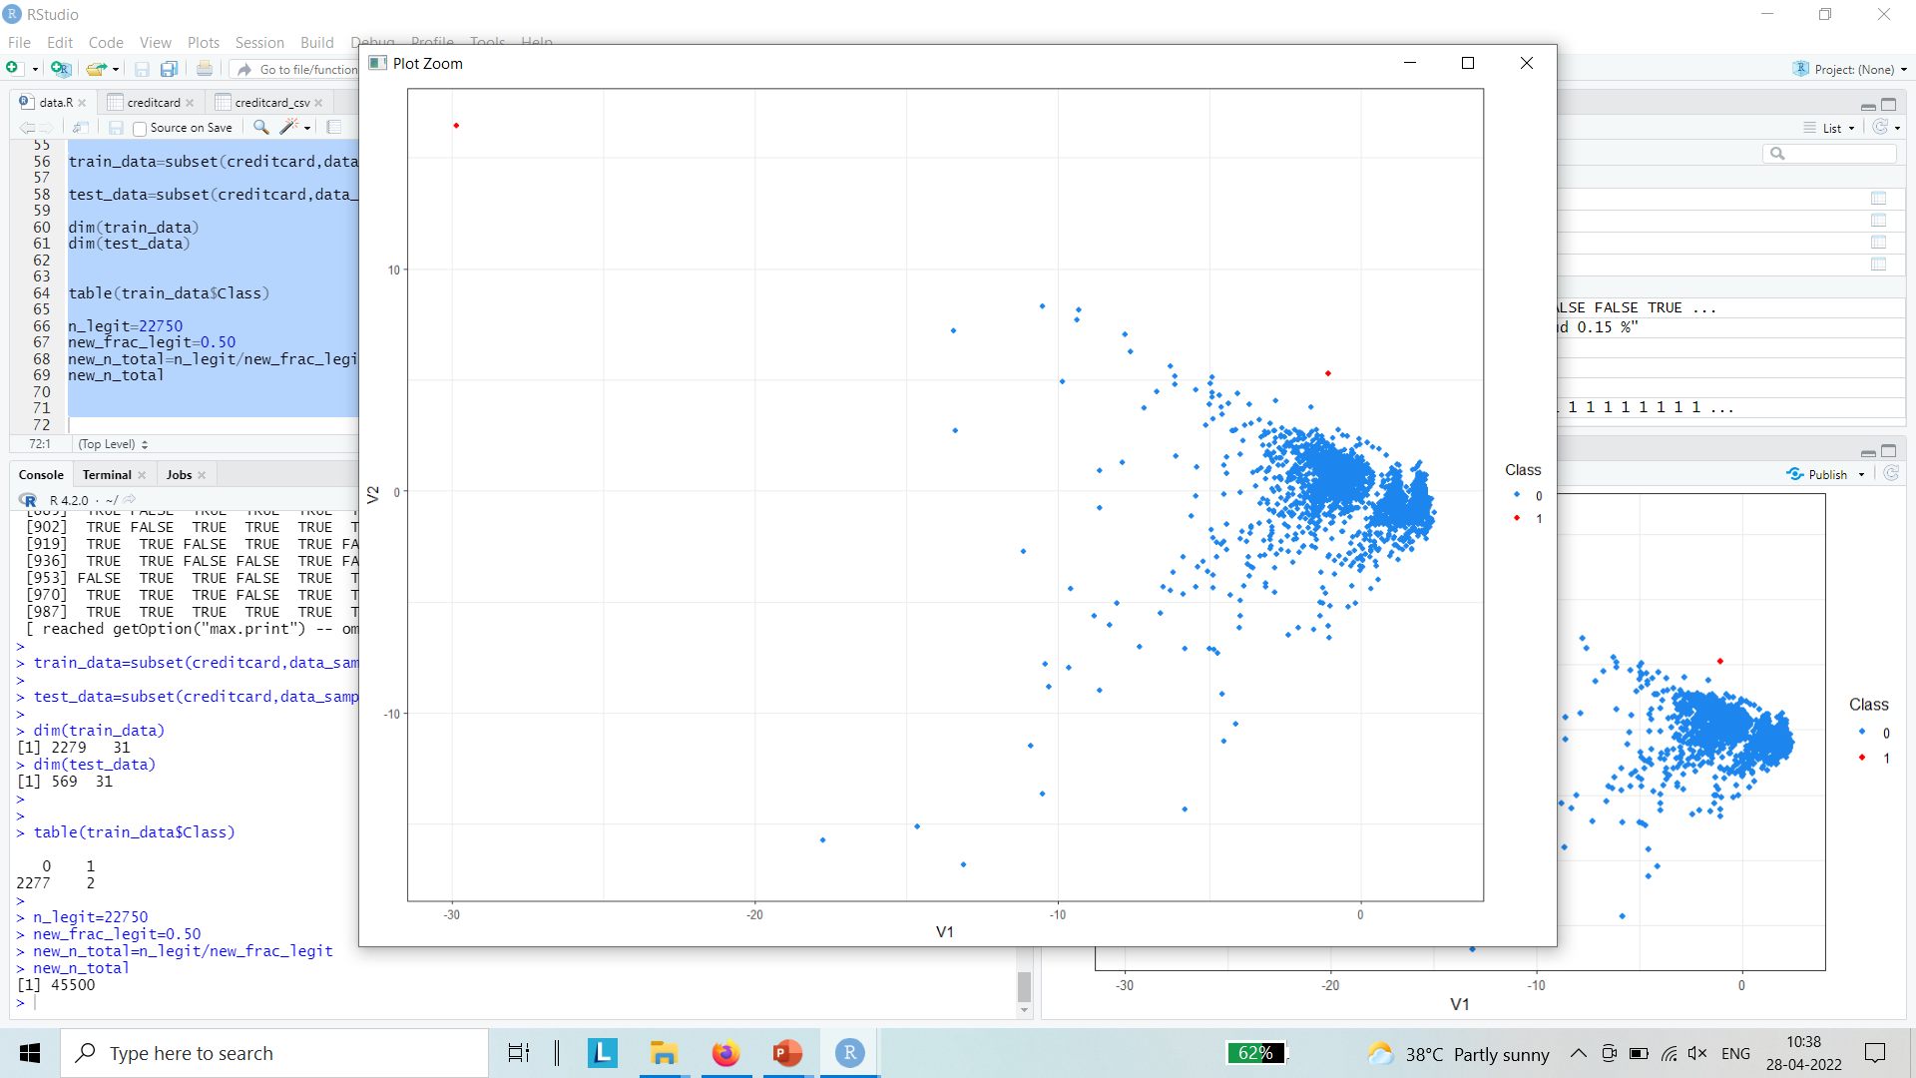
Methodology
Inside this dataset, there are 31 columns out of which 28 are named as v1-v28 to protect sensitive data.
The other columns represent Time, Amount and Class. Time shows the time gap between the first transaction and the following one. Amount is the amount of money transacted. Class 0 represents a valid transaction and 1 represents a fraudulent one.
Plot different graphs to check for inconsistencies in the dataset and to visually comprehend it. We can see 2 plots.
Obtained our dataset from Kaggle, a data analysis website which provides datasets.

Slide 11
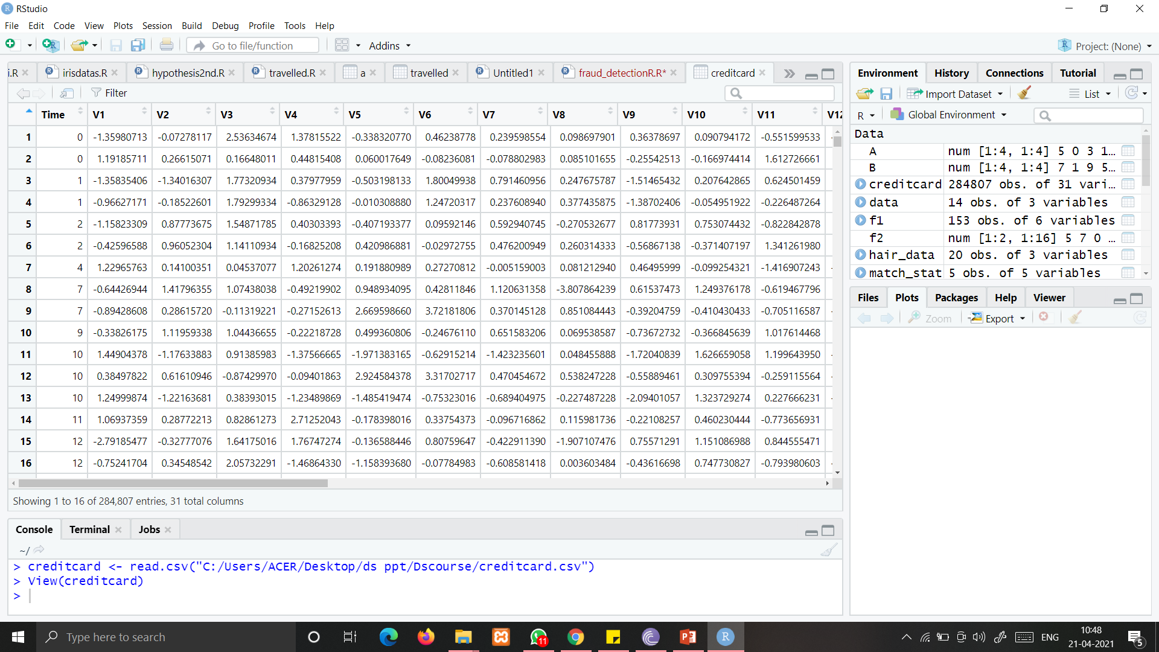

Screenshot of dataset

Slide 12
Challenges while building ml model
Unbalanced data
Less than 0.5% credit card transaction are fraud
Operational efficiency
Less than 8 sec to flag a transaction
Incorrect flagging
Avoid harassing real customers

Slide 13
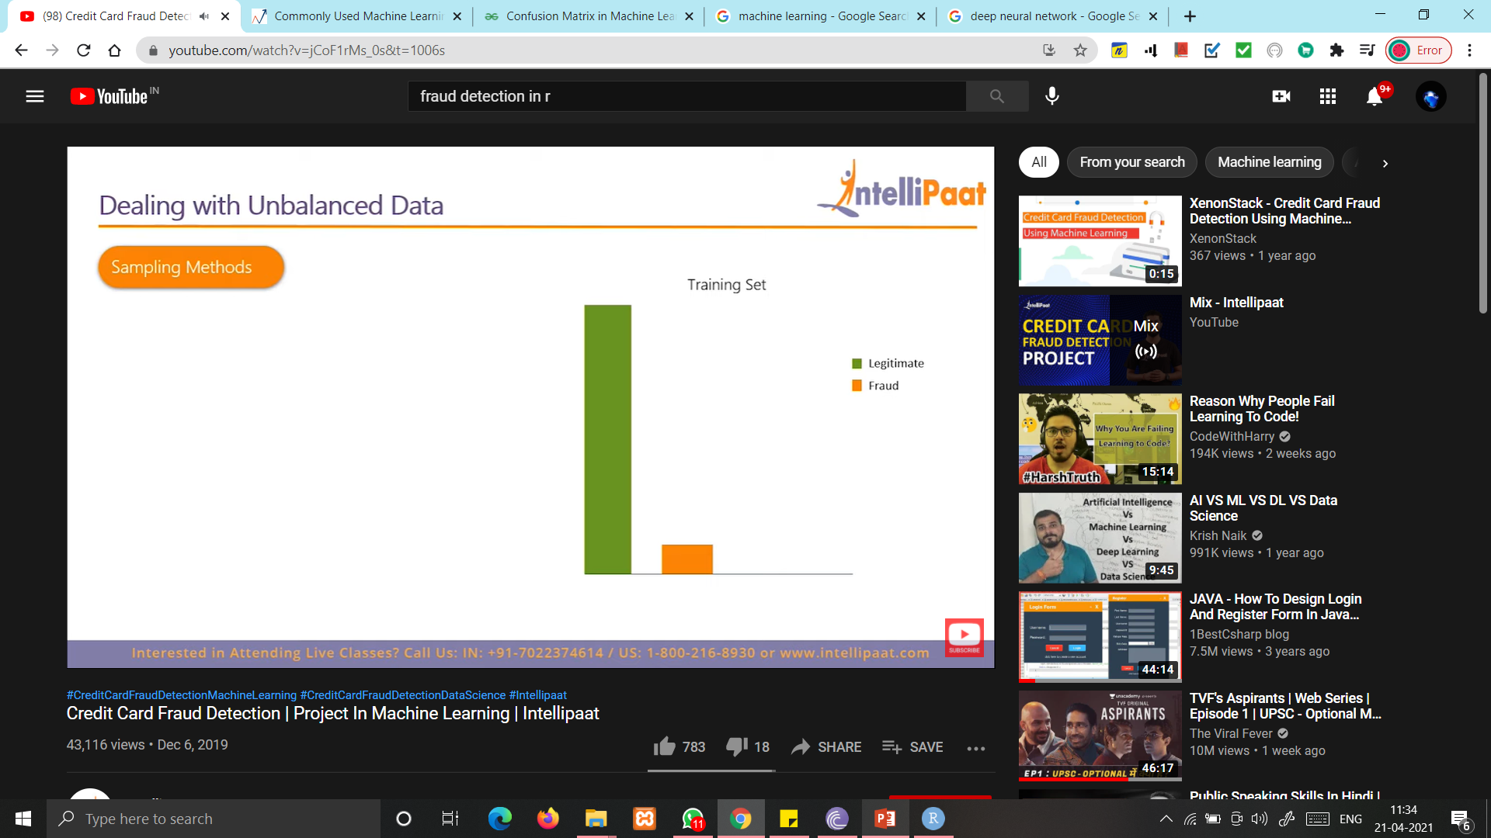
Dealing with unbalanced data
Classifier tends to favour majority =(legitimate)
Large classification error over fraud set
Classifier learns better with balanced distribution

Slide 14
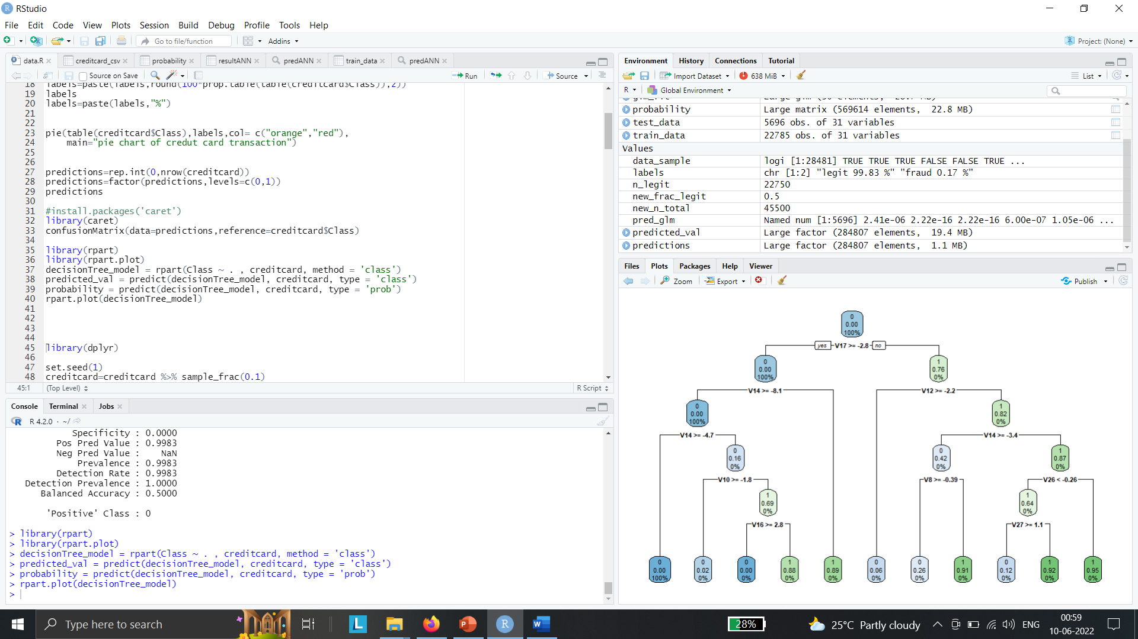
Models to use
Fitting a Decision Tree Model: Decision Trees to plot the outcomes of a decision. These outcomes are basically a consequence through which we can conclude as to what class the object belongs to.

Slide 15
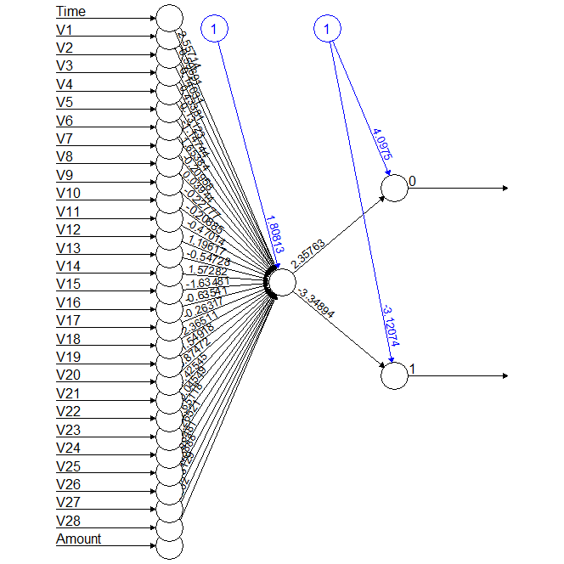
Models to use
Artificial Neural Network: Artificial Neural Networks are a type of machine learning algorithm that are modeled after the human nervous system. The ANN models are able to learn the patterns using the historical data and are able to perform classification on the input data.

Slide 16
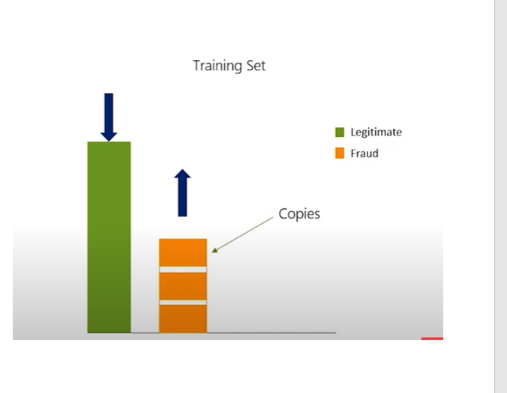
Models to use
Sampling Methods
Random over sampling
Random under sampling
Both

Slide 17
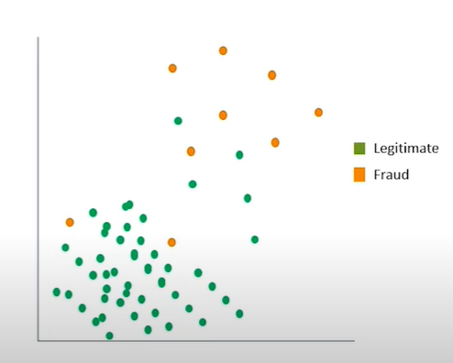
SMOTE
Synthetic Minority Oversampling Technique (SMOTE) is a statistical technique for increasing the number of cases in your dataset in a balanced way. The component works by generating new instances from existing minority cases that you supply as input
Over sampling minority class by creating synthetic fraud cases

Slide 18
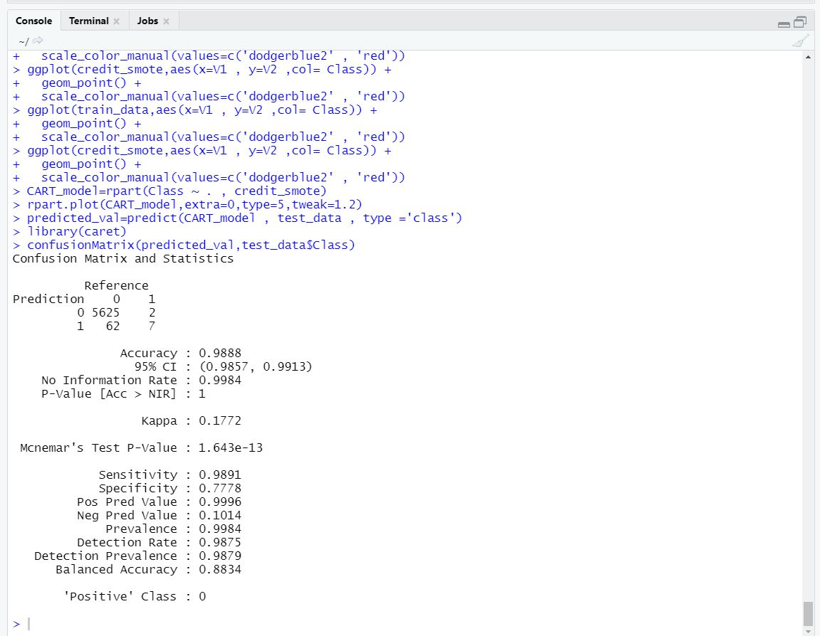
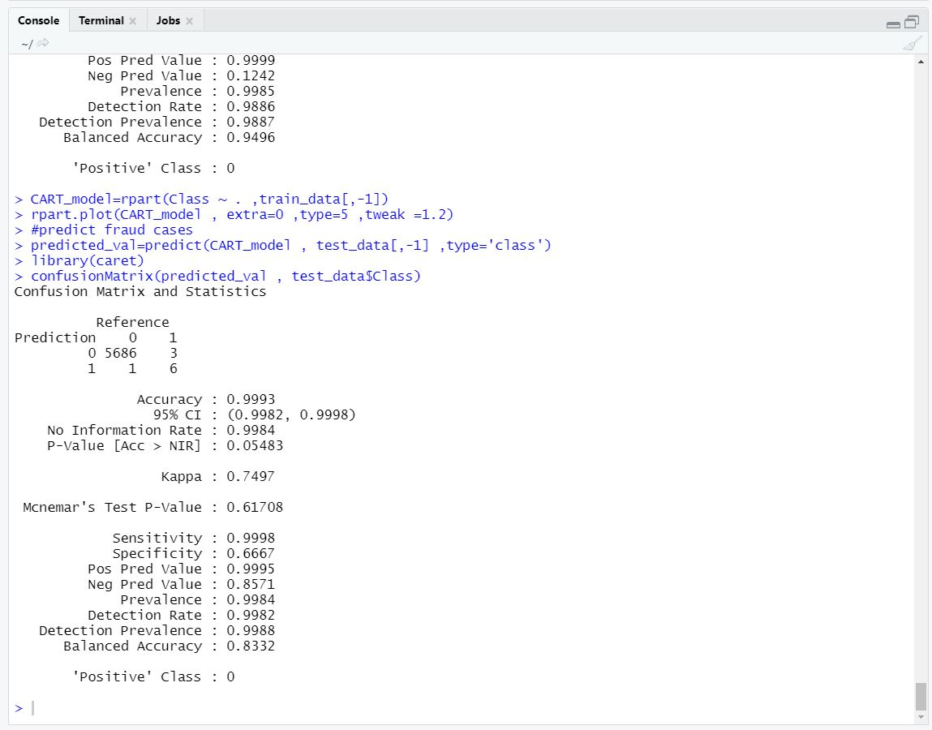
Results
Result 1 for prediction using SMOTE method: We can see that when we use SMOTE analysis for small test set data we get the accuracy as 7 out of 9 fraud cases.
Result 2 for prediction without using SMOTE method: We can see that when we Not use SMOTE analysis for small test set data we get the accuracy as 6 out of 9 fraud cases.

Slide 19
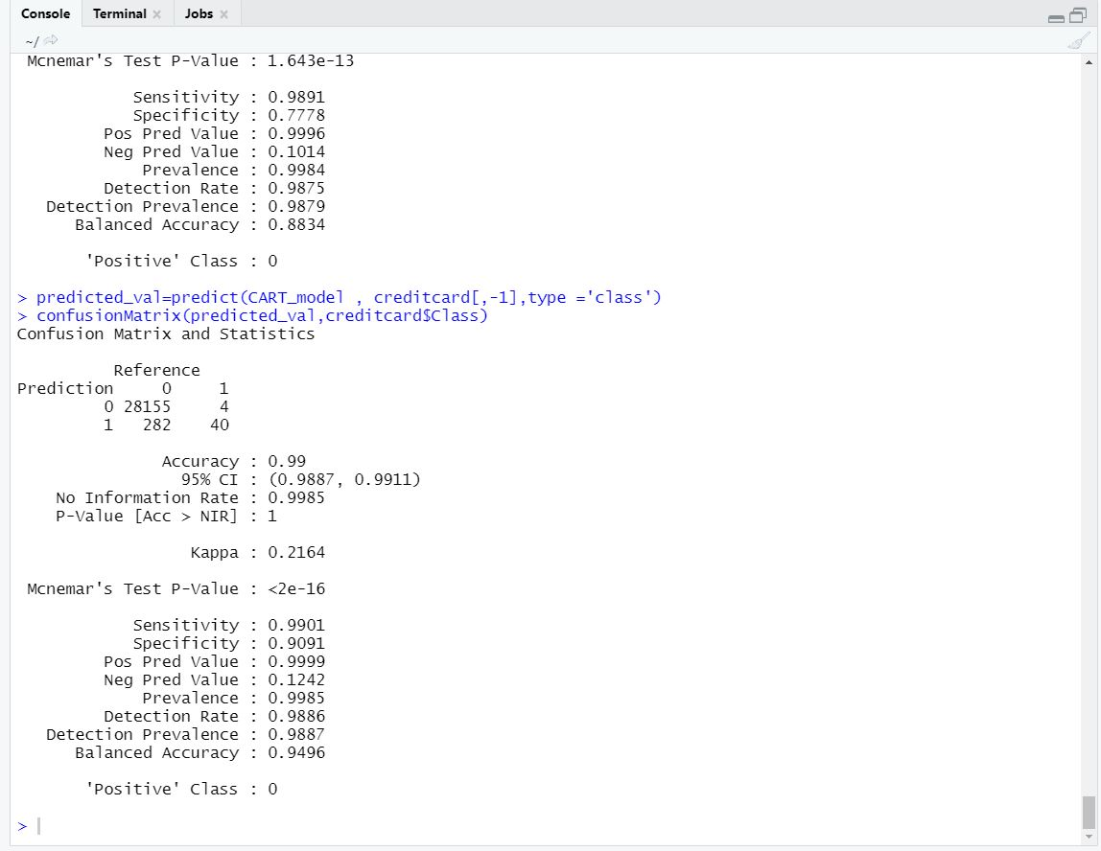
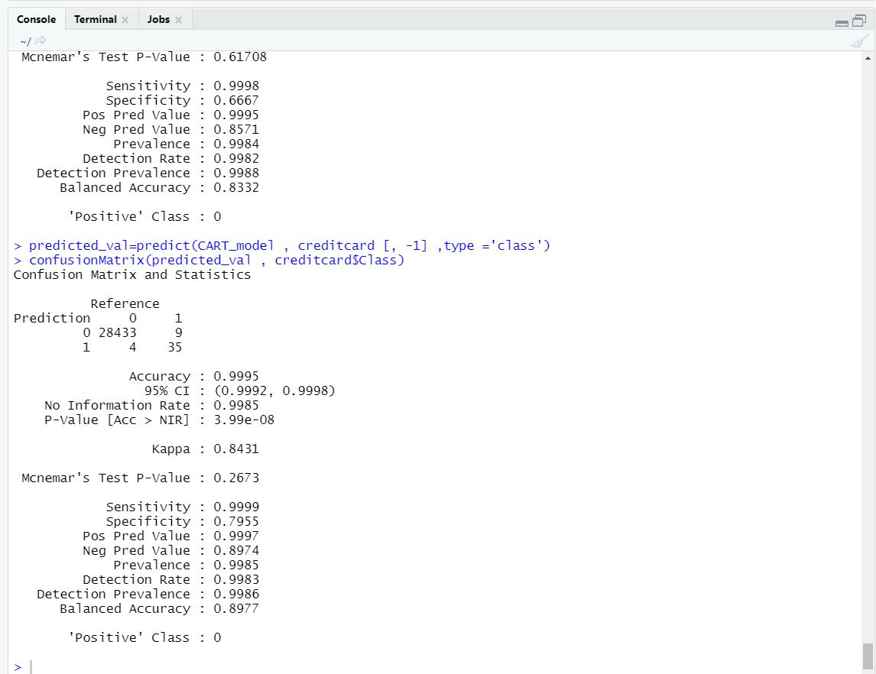
Results
Result 3 for prediction with using SMOTE method for Original data: We can see that when we use SMOTE analysis for original set of data we get the accuracy as 40 out of 44 fraud cases
Result 4 for prediction without using SMOTE method for Original data: we can see that when we Not use SMOTE analysis for original set of data we get the accuracy as 7 out of fraud cases.

Slide 20
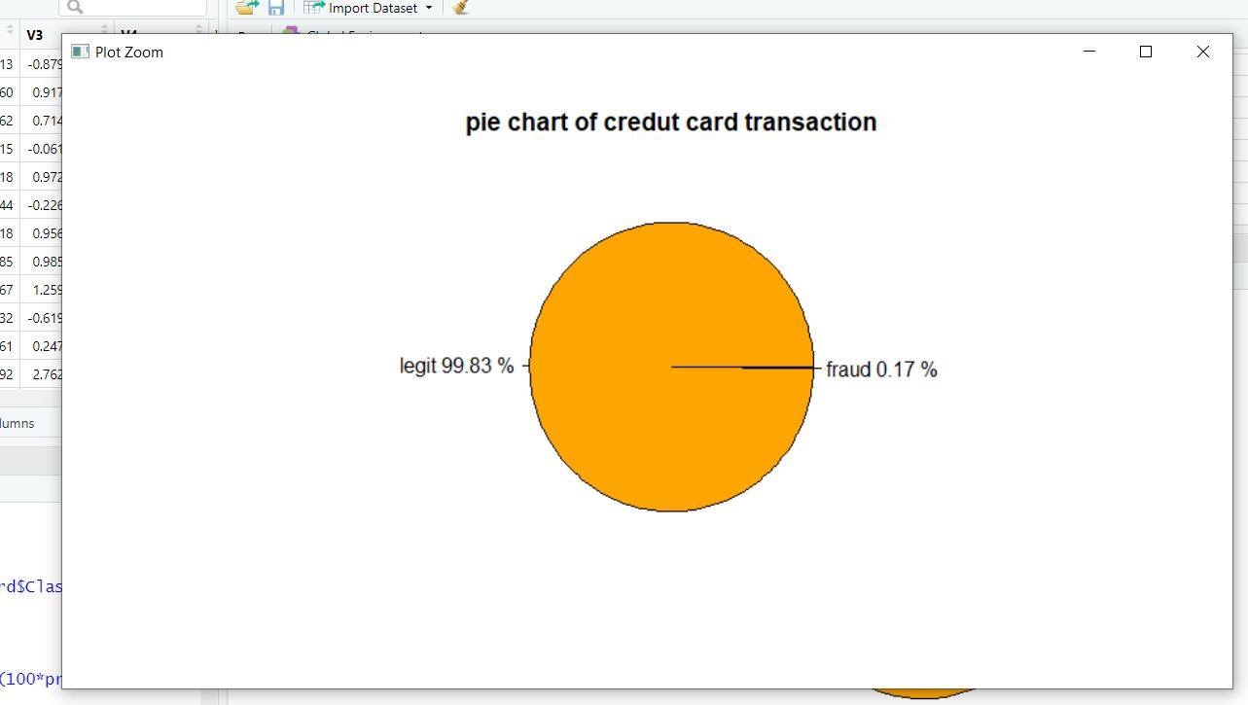
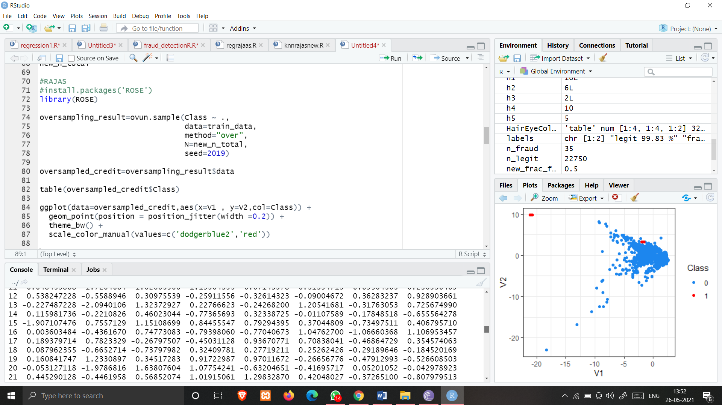
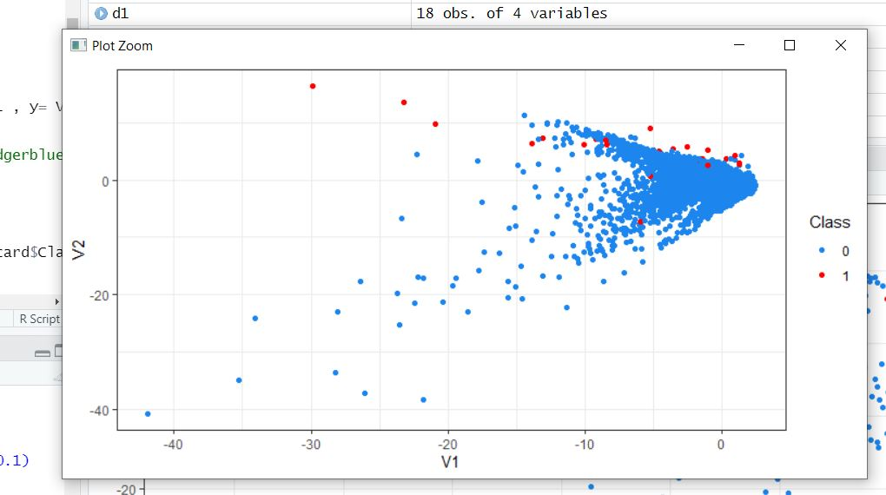
Screenshots of curves
Pie chart graph for actual data set visualization having legit and fraud label
Graph for visualization of small proportion of data set carved out from original data set
Graph for Random Over sampling of dataset derived from train dataset

Slide 21
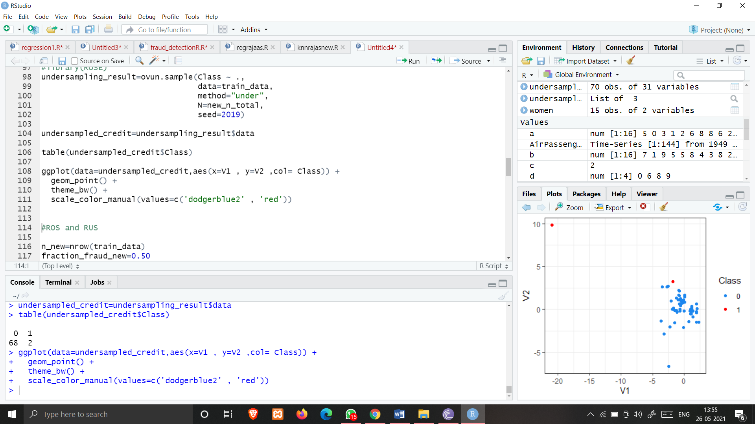
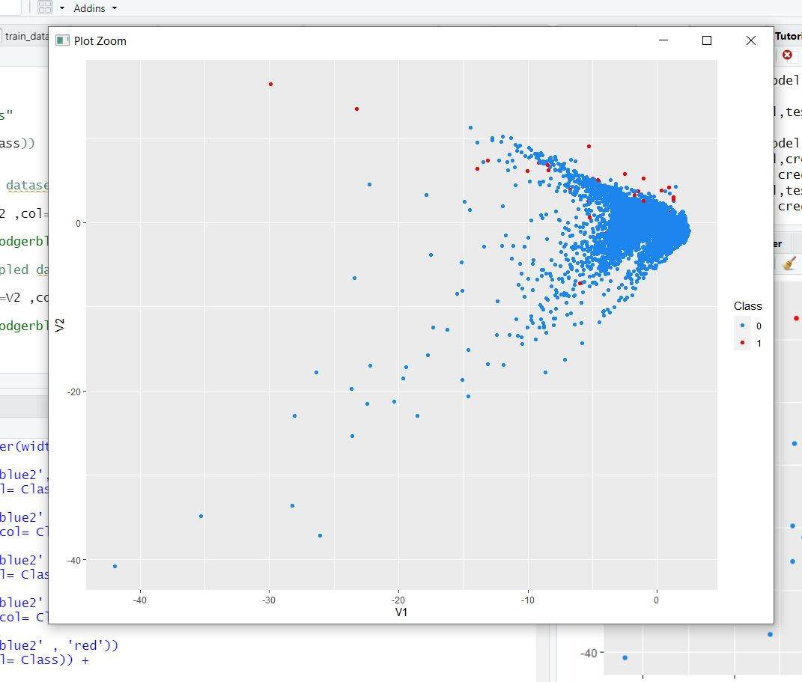
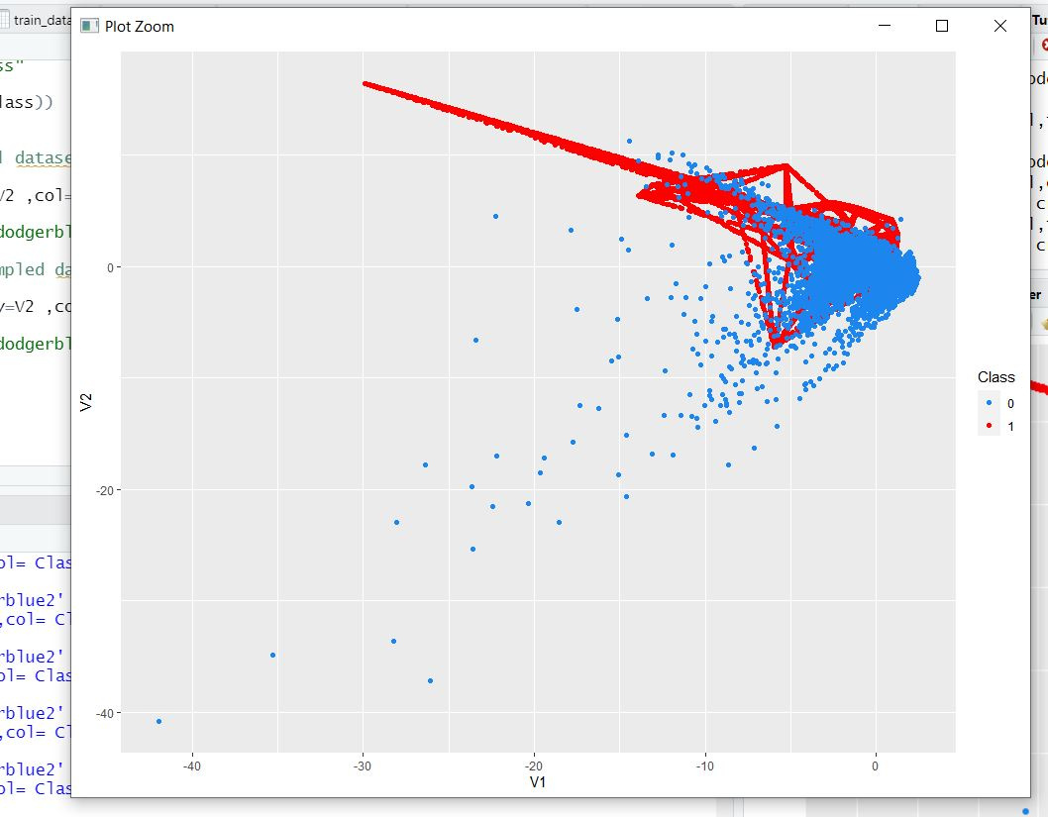
Screenshots of curves
Graph for Random Under sampling of dataset derived from train dataset
Graph of train data set for comparison with respect to SMOTE graph
Graph SMOTE method to see for synthetic samples added

Slide 22

Data can be analyzed and visualized to discern fraudulent transactions from other types of data using different machine learning algorithms
SMOTE analysis for prediction for legitimate and fraud cases in credit card detection system is useful where there is huge amount of imbalanced data
We can use SMOTE classification model which easily classifies the given data and correctly predicts us the desire cases for the fraud with appealing accuracy instead of original unbalanced data further there is more
By comparing all the various sampling methods, we found that SMOTE analysis is most favourable for the given dataset

Slide 23
REFERENCES
Credit Card Fraud Detection Based on Transaction Behavior -by John Richard D. Kho, Larry A. Vea published by Proc. of the 2017 IEEE Region 10 Conference (TENCON), Malaysia, November 5-8, 2017
L.J.P. van der Maaten and G.E. Hinton, Visualizing High-Dimensional Data Using t-SNE (2014), Journal of Machine Learning Research
Research on Credit Card Fraud Detection Model Based on Distance
Sum – by Wen-Fang YU and Na Wang” published by 2009
International Joint Conference on Artificial Intelligence
Machine Learning Group — ULB, Credit Card Fraud Detection (2018), Kaggle

